Slide 1


Chapter 4
Making apps do significant computing

Slide 2
Learning objectives
1. How to validate input
2. How to do computations based on input
3. How to do conditional computing
4. How to do iterative computing
5. How to use arrays in JavaScript

Slide 3
Temperature converter app design
The objective: to allow users to convert temperature from Fahrenheit to Celsius, and vice versa.
Simple and intuitive
App is on one screen
Users of our app will be able to input a temperature in one scale, either Celsius or Fahrenheit, and convert it to the other scale.

Slide 4
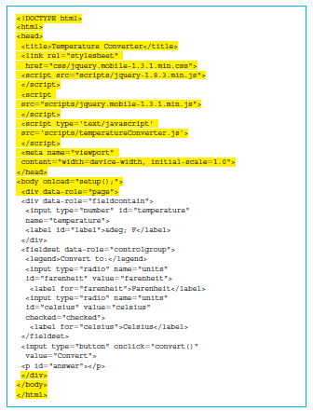
Simple JavaScript calculations for temperature conversion app
Create a single screen that accepts the temperature and a radio button that tells us whether the temperature is in Fahrenheit or Celsius.

Slide 5
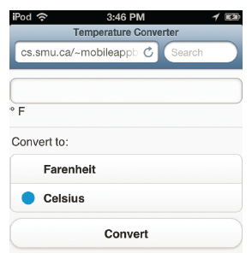
Screenshot of Temperature Fahrenheit app

Slide 6
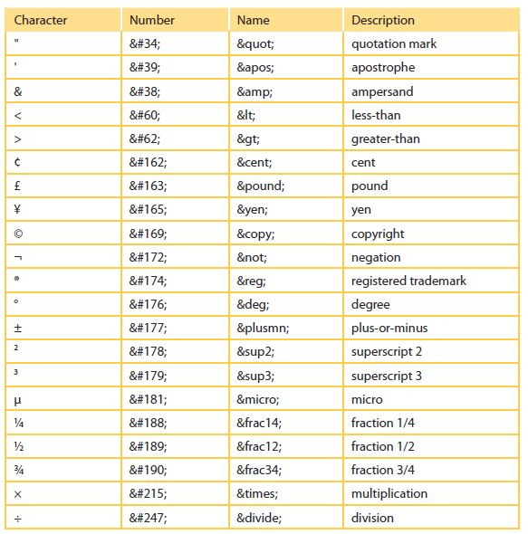
A table of frequently used symbols in HTML5

Slide 7
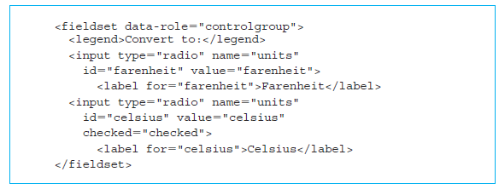
HTML5 Code for the radio button for temperature types
HTML5 code that is wrapped in a <fieldset> HTML5 element.
Caption “Convert to:” for our <fieldset>.

Slide 8
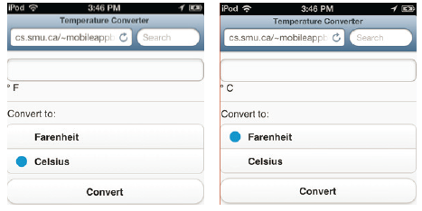
Screenshot of switching temperature types

Slide 9
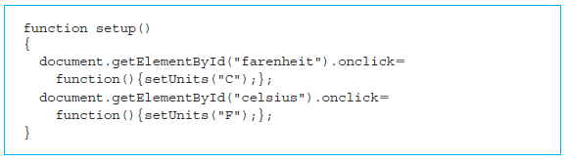
JavaScript for the setup() function; executed when the page is loaded
The value of the attribute “onload” tells the browser to run the JavaScript function setup().
document.getElementById("fahrenheit").onclick defines the action when the radio button with id “fahrenheit” is clicked.

Slide 10
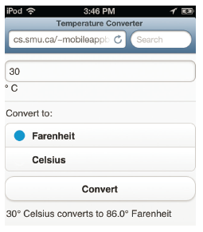

Elements that trigger actual computations and display results
The <input> element with attribute value of type “button” is shown below.

Slide 11
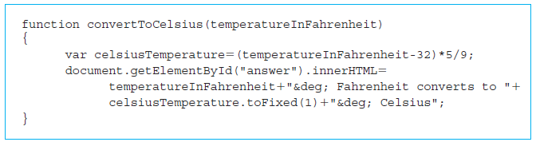
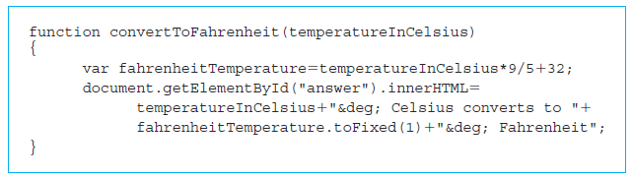
JavaScript functions for conversion

Slide 12
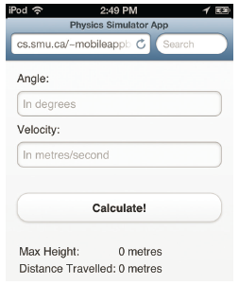
Projectile app to calculate distance and height of a projectile
Our JavaScript functions are in a file called physicsProjectileApp2.js
The <body> tag has an attribute called “onload”, which will call the JavaScript function “initialize()”
The button in the form now is called “Calculate!” instead of “Display” and triggers a JavaScript function “update()”

Slide 13
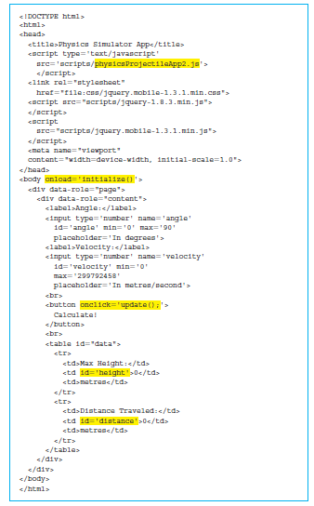
HTML5 code for the second Projectile app

Slide 14
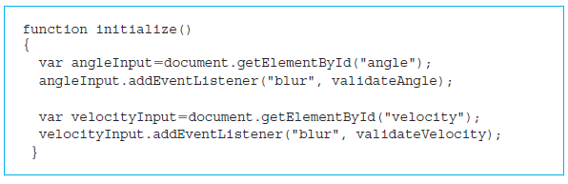
Validating input values in an app using Boolean expressions in JavaScript
Error checking in the second Projectile app by the JavaScript function “initialize()”.

Slide 15
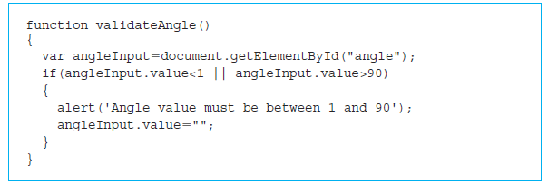
Validating input values in an app using Boolean expressions in JavaScript (cont’d)
JavaScript function validateAngle() is called when the user has entered the value of the angle.
• angleInput.value < 1
• angleInput.value > 90

Slide 16
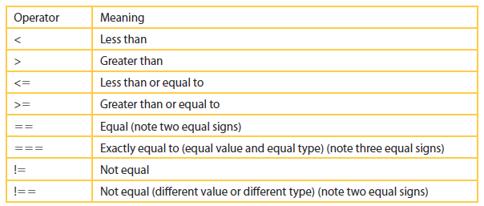
Comparison operators in JavaScript

Slide 17
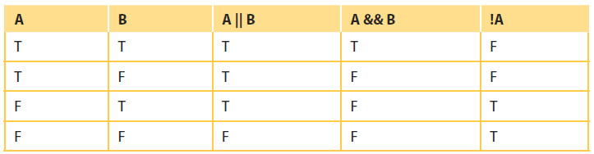
Boolean operators in JavaScript

Slide 18
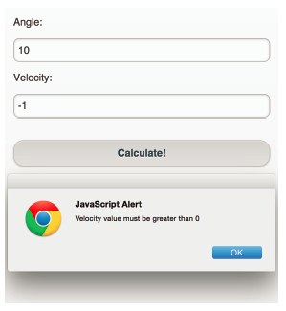
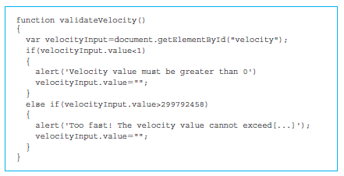
Validating angle and velocity
JavaScript function validateVelocity() ensures that the velocity is greater than 0 and less than 299,792,458 (speed of light).

Slide 19
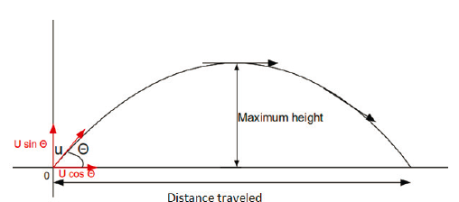
Calculation of distance and height of a projectile using JavaScript Math object
1.
2.
3.
4.

Slide 20
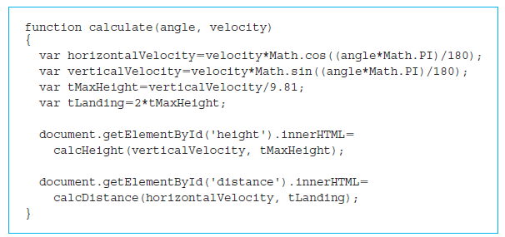
JavaScript code to calculate and display height and distance of projectile

Slide 21
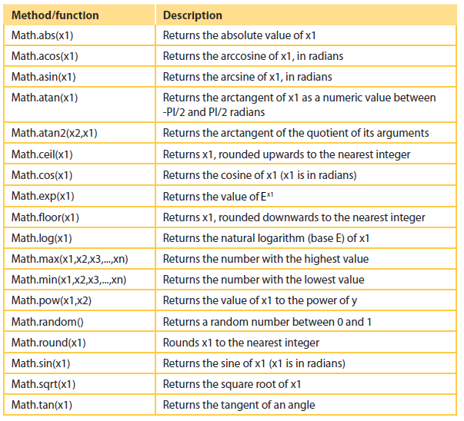
JavaScript Math object methods or functions

Slide 22
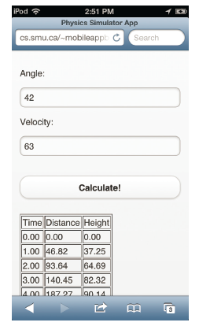
JavaScript arrays for storing distances and heights over time of a projectile
Track the projectile throughout its flight.
Tabulate the height and distance traveled by the projectile.
Code: the only difference is the table with id “data”.
JavaScript function will dynamically add the rows and columns after calculation.

Slide 23
Overview of arrays in JavaScript
An array variable is declared as var.
var a = []
An array is a convenient data structure provided by most programming languages to store a sequence of n elements such as: a₀, a₁, a₂,…, a_{n-1}.
Can find the length of the array by looking at the length property: a.length
The length of JavaScript arrays is also flexible.

Slide 24
More commands
a.push("Appending a string") adds a new element at the end of the array.
Insertion of an element at the beginning of an array with the statement a.unshift(90)
The deletion of an element from the end is done using a.pop()
a.shift(): deletes the first element and returns its value.
d = b.concat(c)
e.push("actionscript")
e.push("c#")

Slide 25
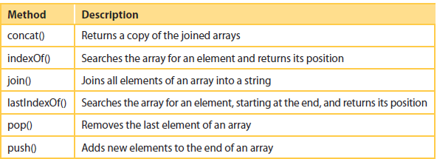
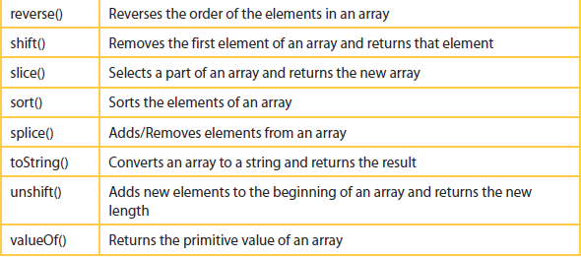
Operations on an array object in JavaScript

Slide 26
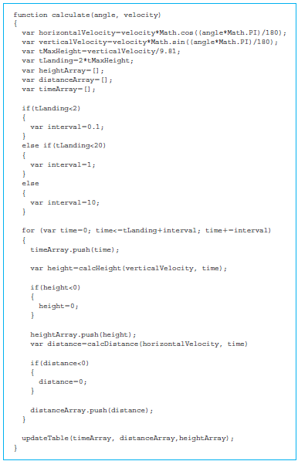
JavaScript for loop for repeating computations
Modified version of our calculate() function.

Slide 27
JavaScript for loop for repeating computations (cont’d)
for(initialization; condition testing; reinitialization)
{
Body;
}

Slide 28
Dynamically adding rows and cells in a table using JavaScript
Add the rows and columns dynamically using our JavaScript function updateTable()
Assign an empty string to the innerHTML property of the table;
insertRow() and insertCell().
dataTable.insertRow(0)

Slide 29
Quick facts/buzzwords
data-role field: Contains jQuery convention to assign a data-role to a <div> element to wrap a number of related form fields.
<fieldset>: HTML5 tag to include related radio buttons.
<legend>: HTML5 tag to define a caption for <fieldset> elements.
onload: Property of <body> element that is used to specify the function that will be executed when the web page is loaded.
special symbols: HTML5 defines special code to include special characters such as &deg; used in the Temperature conversion app.

